Slide 1
Visibility and Communication
A Module in Agile Fundamentals
This work is licensed under the
Creative Commons Attribution-ShareAlike 4.0 International License.
To view a copy of this license, visit http://creativecommons.org/licenses/by-sa/4.0/.
Notes:
Plan, execute and report on Agile projects
--------------------------------------------------------------------------------------------------------------------
In this module, we’ll explore the practices that help Managers and Project Managers plan, execute, and report on Agile projects.
<number>
Visibility and Communication

Slide 2
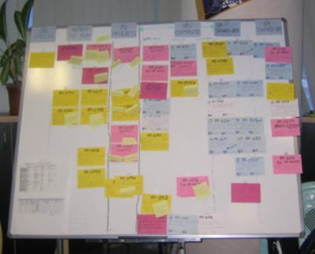
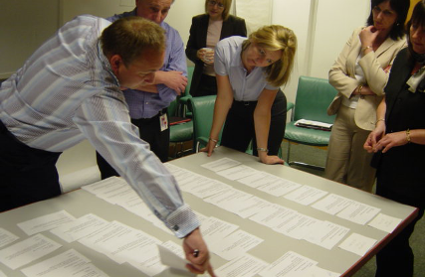

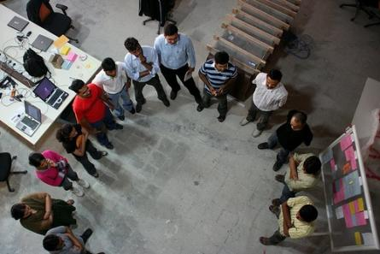
Key Agile Meetings
Iteration Planning
Showcase
Stand Ups
Retrospectives
Notes:
3 of these meetings can be done distributedly.
We discourage distributed Release Planning.
Mountain goat software has distributed Planning Poker.
Ideaboardz and Edistorm are good for distributed Retrospectives.
<number>
Visibility and Communication

Slide 3
Maintaining Visibility and Communications
Notes:
Accurate visibility into project progress has traditionally been a problem
Agile address this by making project status extremely visible to everyone
----------------------------------------------------------------------------------------------------------------
One of the exciting and powerful aspects of Agile is the free flow of information and communication. This is true both within an Agile team, and between the team and the rest of the organization. Agile teams talk about transparency, meaning that facts and information are freely available at all times, and that our successes and failures are equally visible.
<number>
Visibility and Communication

Slide 4
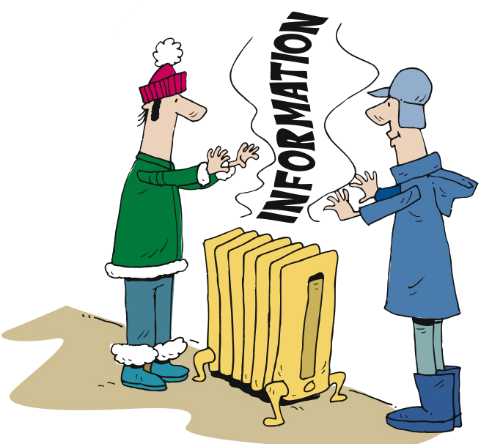
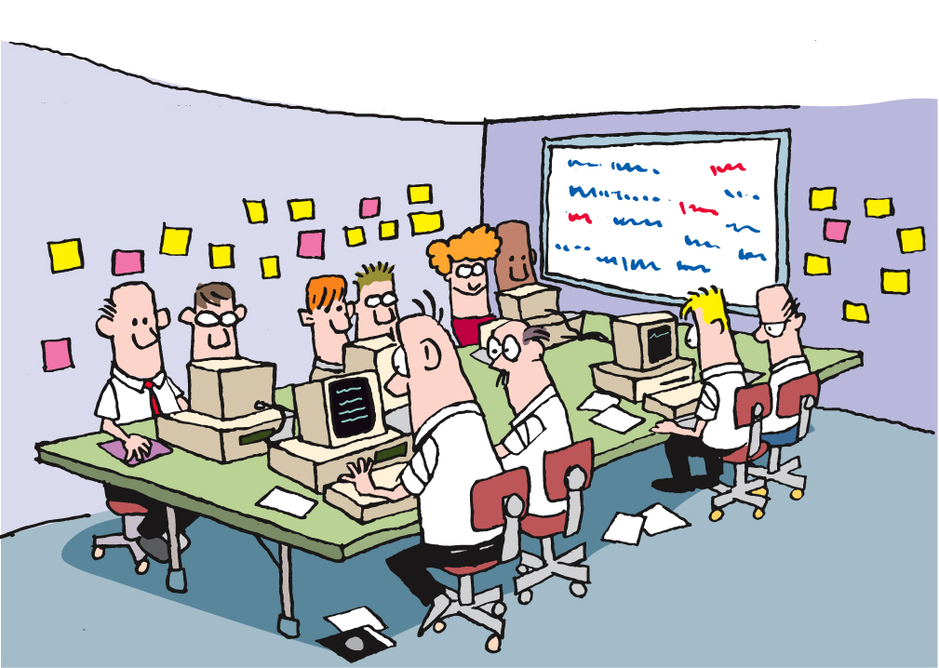
Information Radiators
Notes:
Static sources of information available to anyone who chooses to view them.
No request needed
Always updated and ready to view [CLICK]
Standard ones [CLICK]
Custom ones
----------------------------------------------------------------------------------------------------
One of the tools for this communication and transparency is a category of things that we refer to as “information radiators”.
[CLICK]
Information radiators are static sources of information that are available to anyone who chooses to view them. By “static” we mean that there is no request needed and no specific interaction (although we’ll get back to this when we talk about Mingle). Rather, information radiators provide information simply by viewing them. Examples [CLICK] are the card wall and the burn-up chart which we touched on briefly a bit earlier in this module. The card wall is always there, and anyone can look at it and learn the state of the project, release, or iteration.
<number>
Visibility and Communication

Slide 5
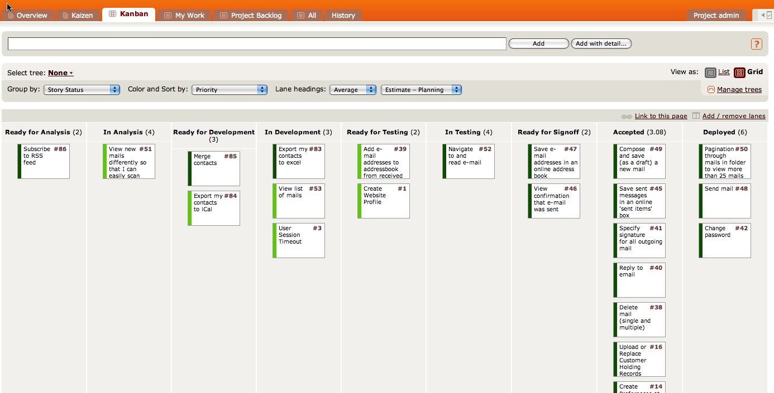
The Card Wall
Notes:
Card wall is in the team room
Easily accessible and visible
Mingle example [CLICK]
Not methodology dependent – scrum, lean, xp
Single iteration
Showing state of the card [CLICK] Ready for Analysis to Deployed
Some cards in next iteration – Analysts typically work iterations ahead of development
Clearly see the status of the iteration [CLICK] [CLICK]
--------------------------------------------------------------------------------------------------------
We’ve talked about the card wall throughout this course. Let’s look at it again, and an example of a card wall in Mingle.
[CLICK] It’s hard to overstate the value of the card wall. Regardless of the approach you follow – Scrum, XP, or Lean, for example – there is a card wall, and the value of it lies in its ability to communicate so clearly and completely, requiring little effort on the part of the reader.
Here’s an example of a representation of a card wall in Mingle. As you can see, this card wall is focused on a single Iteration, covering states [CLICK] from Ready for Analysis to Deployed. In many cases, the stories in the Ready for Analysis and In Analysis states are actually being prepared for the next Iteration. The work of Business Analysts is generally an Iteration ahead of the rest of the team, allowing them the time they need to figure out details and acceptance criteria so that the stories will be ready for the development team.
As you can see here, it’s easy to understand the state of the work being done in an Iteration on the card wall. For instance,[CLICK] we can see that there are a number of stories on which the work is complete that are waiting to be deployed. At the other end, [CLICK] there are a couple of stories that are ready for development, [CLICK] a few in development, and so on. Without even looking at the specific stories, [CLICK] we can learn a great deal about the project just by seeing the flow of work through viewing the card wall.
<number>
Visibility and Communication

Slide 6
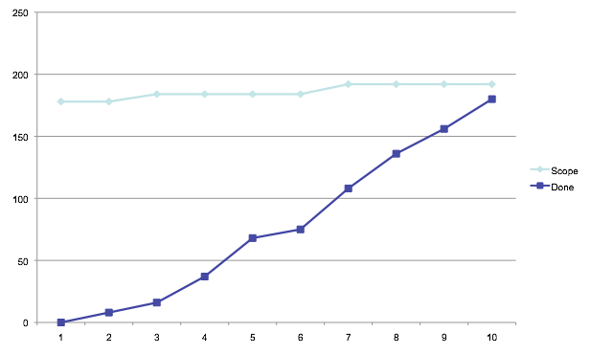
Project Burn-Up
Scope
Velocity
Notes:
Burn-Up Chart
Primarily discussion, with an example of a burn-up chart
Visibility and Communication

Slide 7
Questions?
Notes:
<number>
Visibility and Communication

